Slide 1
Dragger2
Content
Dependency Injection
Dagger 2
2020/02/25
India SW Lab

Slide 2
Dependency Injection
Dagger 2

Slide 3
Dagger 2
Pure Dependency Injection
Emergence of Dependency Injection
Fundamental Theory

Slide 4
1.Dependency Injection
Class A
Makes use of
Class B
Client
Service

Slide 5
Class A
Service
Makes use of
Class B
Client
Makes use of
Class C

Slide 6
How Clients obtain references to Services
Receive References from “outside”
Active Dependency Resolution
Instantiation
Static method call
Passive Dependency Resolution
Dependency Injection

Slide 7
Fundamental Techniques of dependency Injection
Constructor injection
Method injection
Field Injection
Reflection (Not required)

Slide 8
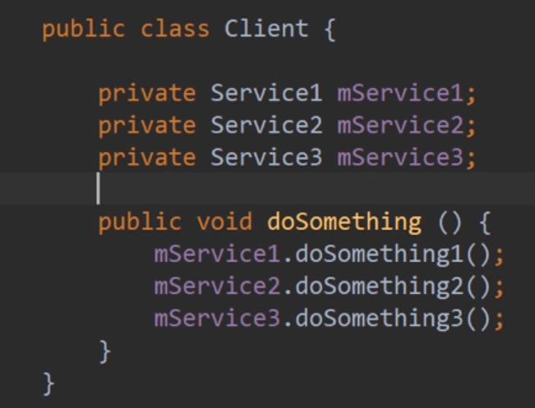
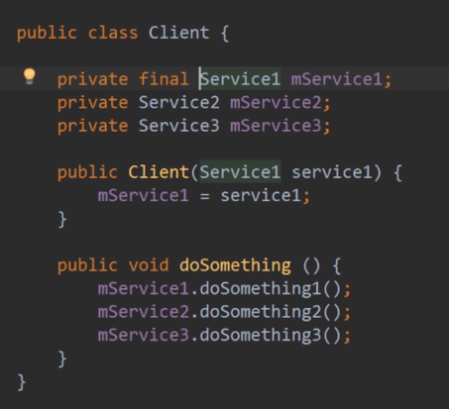
Constructor Injection
Results in Null pointer exception,
because these services
are not initialized
Why final?
Not created any new instance
of the service class

Slide 9
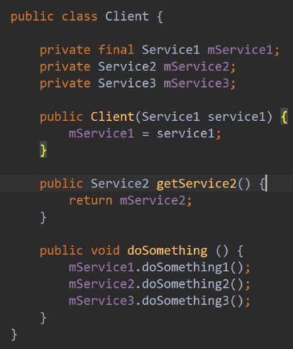
Method Injection
Results in Null pointer exception,
because these services
are not initialized
Not created any new instance
of the service class

Slide 10
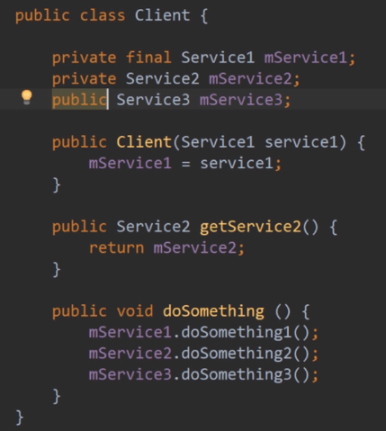
Field Injection
External entity can access
and modify the field

Slide 11
Pros and cons
Constructor Injection
Pros
Simple
Constructor signature reflects dependencies
Injected fields can be finalized[*]
Easy to mock services in unit tests
Cons
None

Slide 12
Pros and cons
Method Injection
Pros
Method signature reflects dependencies
Can happen after construction
Cons
Not as explicit as constructor injection
Can leads to implicit ordering requirements (temporal coupling)

Slide 13
Pros and cons
Field Injection
Pros
Can happen after construction
Cons
All cons of method injection (non explicit, Temporal coupling)
Non-evident dependencies
https://shipilev.net/blog/2014/safe-public-construction/

Slide 14
The best fundamental technique of dependency Injection
CONSTRUCTOR INJECTION
Always use constructor injection unless:-
No service instance when the client is instantiated (e.g. Runtime specified strategy)
You do not instantiate the client (e.g. Activity)
Framework imposed limitation on constructor (e.g. Fragment)

Slide 15
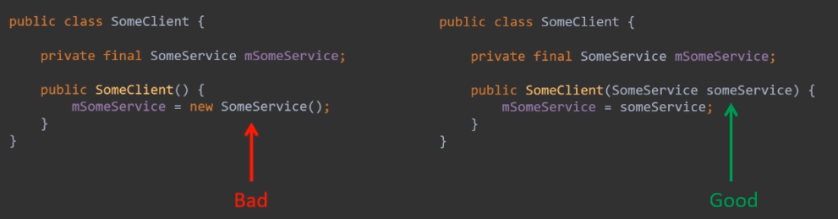
Large scale structure

Slide 16
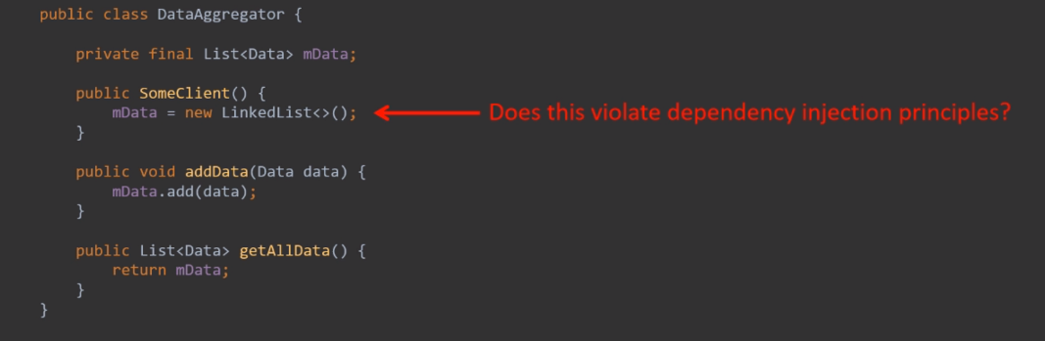
Question 1
Is this the violation of dependency injection?

Slide 17
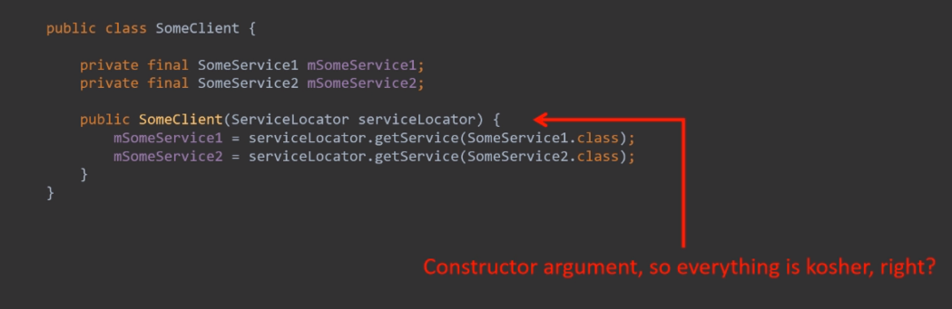
Question 2
Is this a proper injection?

Slide 18
Questions
Question 3:-
Why dependency injection frameworks exist, and why are they so complex?
Question 4:-
If all clients get services from outside, where all these services being instantiated?
https://stackoverflow.com/questions/130794/what-is-dependency-injection

Slide 19
2.Scope of Architectural Patterns
Broad in scope
Give solutions for
business requirements
Not detailed
Architectural pattern not
equal to architecture
Different architectures are
Presentation :- MVx
Notification :- Publish – subscribe (Event bus library)
State change management:- Event driven (offline application)
Narrow in scope
Provide solutions for
very specific software
related tasks
Very detailed (observable)
Vs
Architectural Pattern
Design Pattern

Slide 20
Dependency Injection Architectural Patterns (DIAP)
DIAP is a extrapolation of fundamental dependency injection techniques to a system level
The main characteristic of DIAP is “Segregation of application’s logic into 2 set of classes”, They are : -
Functional Set : - Contains classes that encapsulate core applications functionality
Construction Set : - Contains classes that resolve dependencies and instantiate objects from functional set
Functional and Construction sets must be disjoint.
Application
Functional Set
Construction Set
Integration
Class
Class

Slide 21
Class Level of abstraction
Application level maintainability
Class level unit testing
Application Level of abstraction
Class level testability
Application level maintainability
FDIT
DIAP
Injecting dependencies
to a class
Creating 2 set of class
Functional and Construction
These 2 are closely related and hence they will complicate each other

Slide 22

Thank you

